Slide 1
What’s New in IBM Copy Services Manager V6.3.18.0
Support for FlashSystems Partition Migration
Support for Webhook Notifications from CSM to external applications
Support for FlashSystems Policy Based HA (no replication)
IDEA CSM-I-65 – Support for creating Personal Access Tokens for REST API Authentication
IDEA CSM-I-236 – Allow for customer descriptions on Scheduled Task external script actions
IDEA CSM-I-65 – Support for creating Client certificates for REST API mTLS Authentication
IDEA CSM-I-244 – Support for both TLSv1.3 and TLSv1.2 connections to different z/OS systems

Slide 2
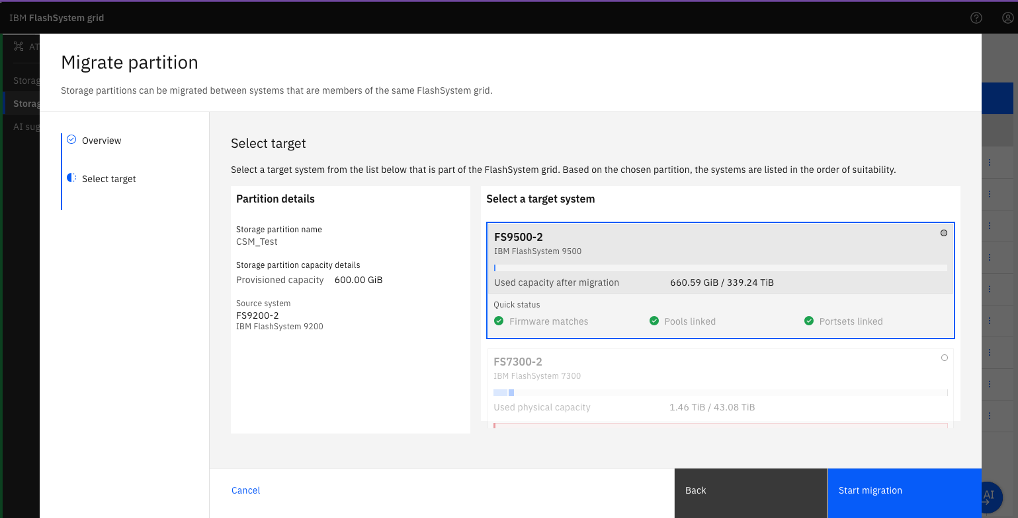
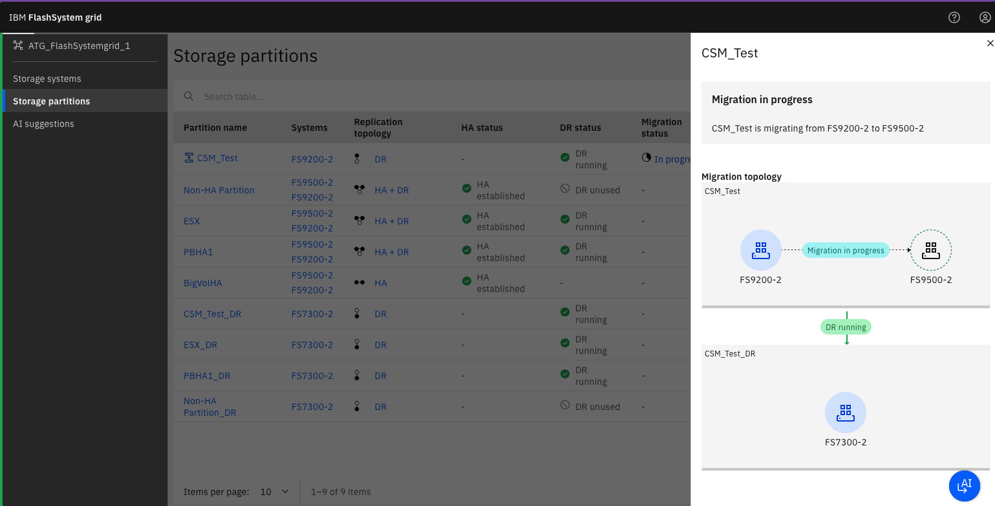
Support for FlashSystems Partition Migration
Partitions that are on a FlashSystem that is part of a grid, can now be migrated to another FlashSystem for various reasons including upgrading hardware, load balancing, etc.
Starting with CSM 6.3.18, Snapshot and Policy Based Replication sessions for Volume Groups within a partition that is migrated, will automatically handle the migration by seamlessly changing the session to the new FlashSystem and updating any scheduled tasks to that session accordingly
Scheduled Task changes do require that the microcode be at 9.1.2 or higher as this requires the new UUID value on the Volume Group
During the migration steps, the CSM session may reflect the High Availability relationships created by the hardware to do the migration but should automatically end up in the new Snapshot session or Policy Based Replication configuration with either the source or target showing as the new Storage System.

Slide 3
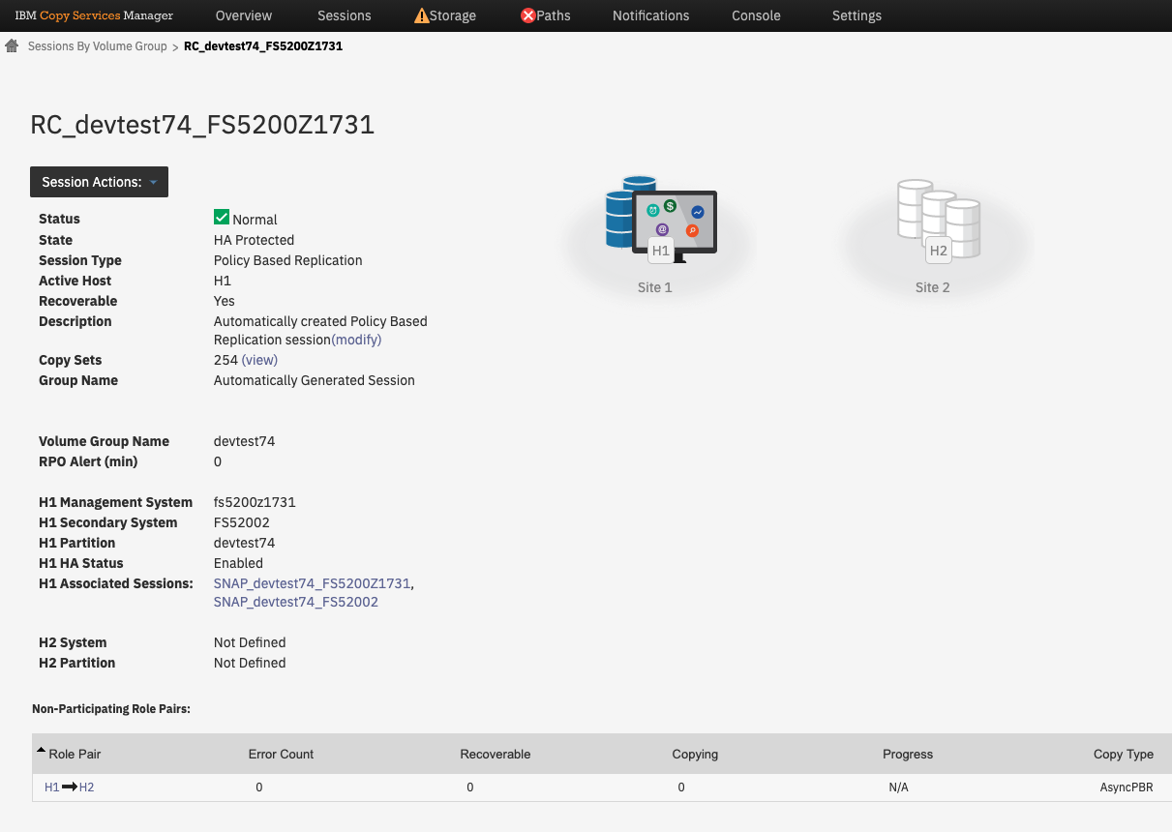
Support for FlashSystems Policy Based HA (no replication)
CSM now supports FlashSystem Volume Groups that only have a High Availability policy with no remote site replication.
Session types have been renamed from Async Policy Based Replication to simply Policy Based Replication
Policy Based Replication sessions look the same whether they support just an HA policy, just an async policy, or an HA + async policy
The session details panel will indicate all of the storage systems that are part of the replication depending on the type of policy
Sessions will automatically convert between types if the replication policy type is changed.

Slide 4
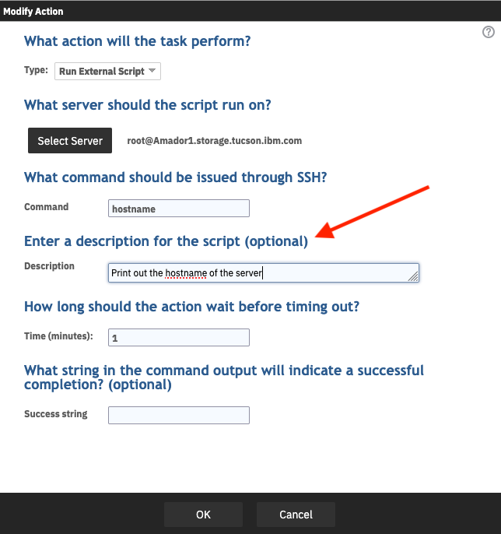
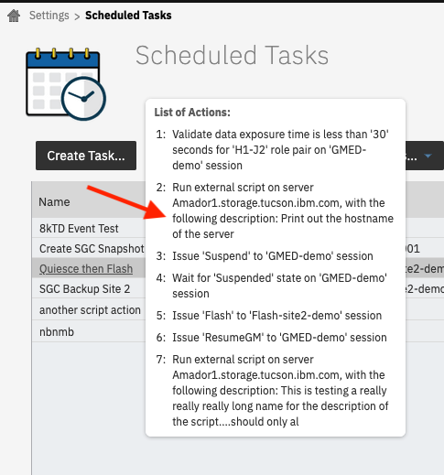
IDEA CSM-I-236 – Allow for customer descriptions on Scheduled Task external script actions
In CSM 6.3.17 we added the name of the script being executed when you viewed the list of actions for a Run External Script action on a Scheduled Task
In CSM 6.3.18 we went a step further and now allow customers to provide their own description of what the External Script being invoked will do
This will appear when you’re editing the task, or if you popup the list of action on the task or view the task summary

Slide 5
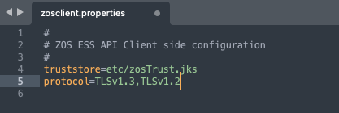
IDEA CSM-I-244 – Support for both TLSv1.3 and TLSv1.2 connections to different z/OS systems
The CSM server can connect via IP to one or more z/OS systems
Today the zosclient.properties file defaults to use TLSv1.2 when it creates the IP connection, however, customers could change that to TLSv1.3 if the system the server was connecting to supported TLSv1.3
However, if a customer is in the middle of moving systems from TLSv1.2 to TLSv1.3, the might need to connect the CSM server to each of these systems with a different protocol
Starting with CSM 6.3.18 you can now provide a comma separated list of the possible protocols to use
The CSM server will attempt the protocols in the order of the list, and negotiate at the highest level based on what the z/OS system allows

Slide 6
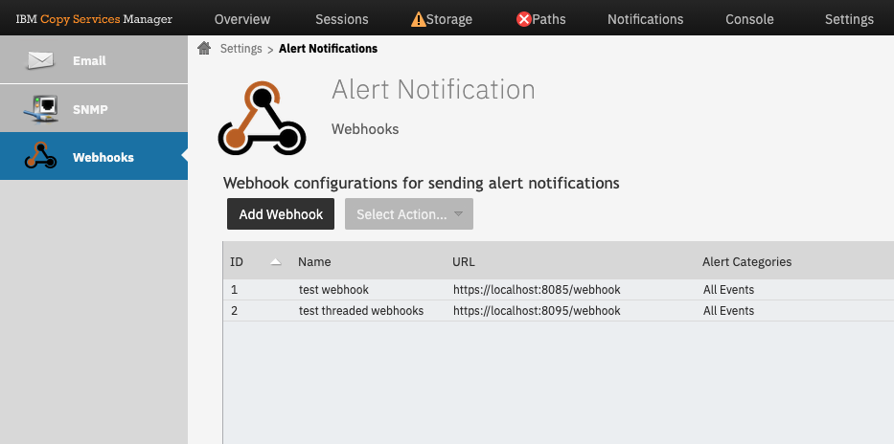
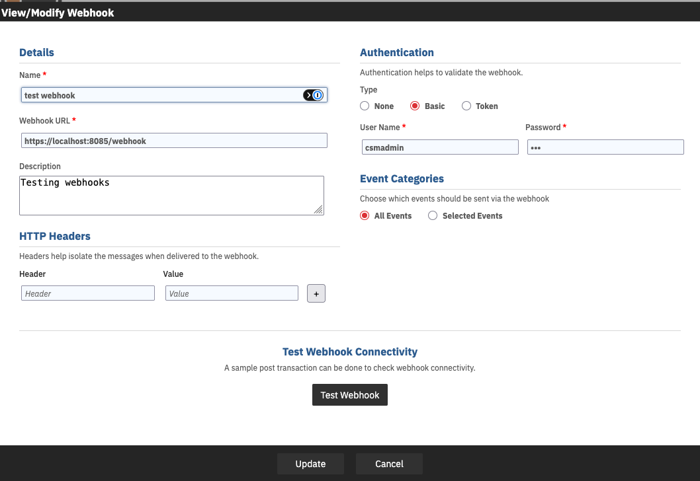
Support for Webhook Notifications from CSM to external applications
Prior to this release CSM supported both SNMP and Email based notifications
Neither SNMP nor email are great mechanisms for programmatic handling of events
External automation or other products that might be monitoring the state of CSM sessions or scheduled tasks, could poll for this information, but this could lead to delays in processing or performance issues
Starting with CSM 6.3.18, customers can now setup a webhook event under the Settings->Alert Notifications panel
Webhooks are meant for program to program event calls
You can specify the URL, headers, authentication information and then choose for the various categories of events the server supports and an event will be sent via the webhook

Slide 7
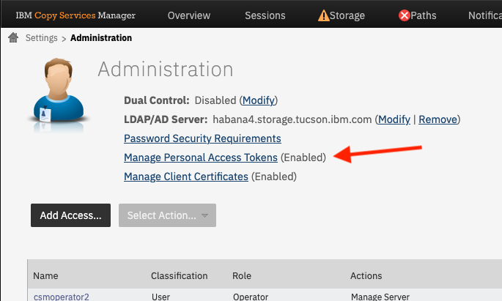
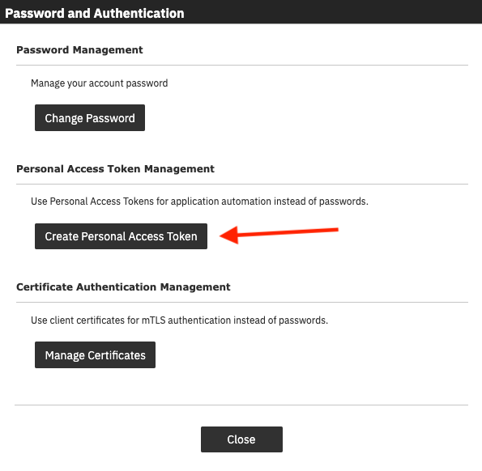
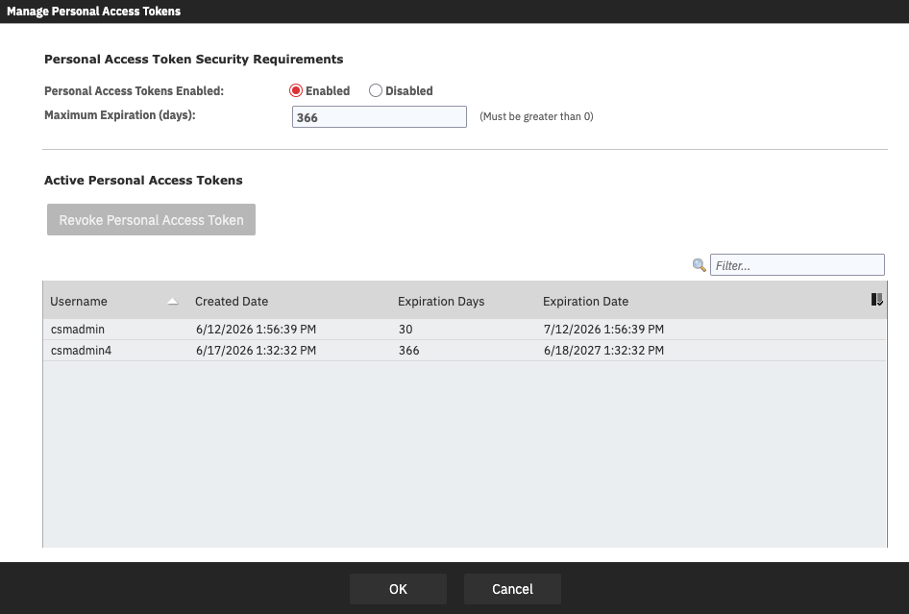
IDEA CSM-I-65 – Support for creating Personal Access Tokens for REST API Authentication
The CSM REST API today supports the creation of a session token using a userid/password
The session token however, automatically expires after 2 hours and has to then be renewed again using a userid/password
Starting with CSM 6.3.18, you can now create a Personal Access Token to be used on the CSM REST API instead
Personal Access Tokens are created from the CSM GUI and are longer lived tokens that can be used with out having to add the userid/password on the automation or application
Admins or User admins have complete control over whether Personal Access Tokens are enabled, the maximum expiration for the tokens, and can even revoke a token at any point

Slide 8
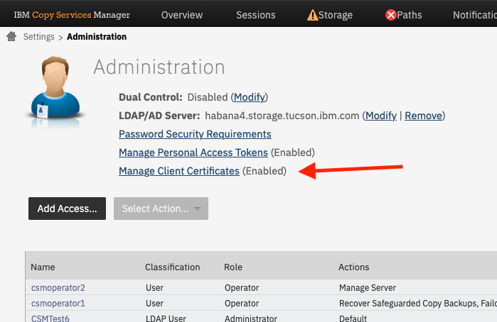
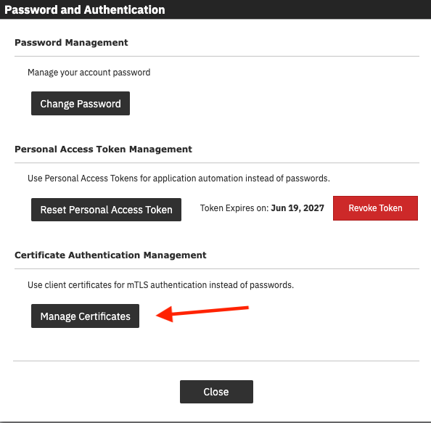
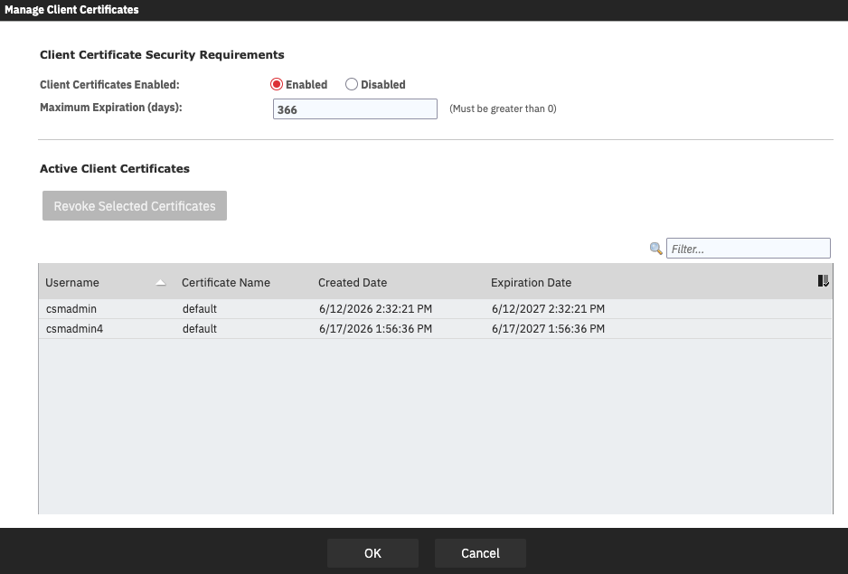
IDEA CSM-I-65 – Support for creating Client Certificates for REST API mTLS Authentication
Starting with CSM 6.3.18, you can now create a Client Certificate to be used on the CSM REST API instead of a session token or Personal Access Token
Client Certificates provide mutual TLS (mTLS) authentication between automation or another application calling CSM using x.509 certificates
To create the client certificate, a user needs to login to the CSM GUI and create the certificate from the Manage Authentication popup
Client certificates can be downloaded and used but are tied to the user that created the certificate and the current role of the user when the certificate is used.
Admins or User admins have complete control over whether certs are enabled, the maximum expiration for the certs, and can even revoke a cert at any point

Slide 9
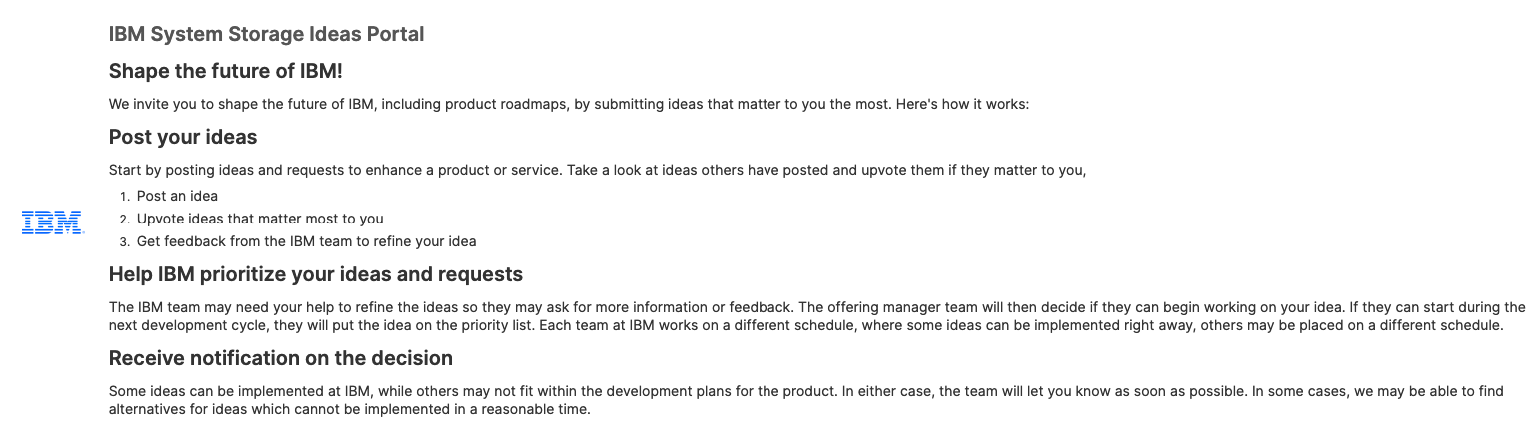
IBM System Storage Ideas Portal!!! -> New RFE Portal for CSM
https://ibm-sys-storage.ideas.ibm.com/ideas?project=CSM
The CSM RFE process has been converted to the new IBM System Storage Ideas Portal.
With the change, IBM is moving to a more common Aha! based process for customers to submit ideas across all IBM products.
All existing RFEs have been converted to Ideas. When you visit an RFE for status it will direct you to the Idea for that RFE in the Idea Portal.

