Slide 1
What’s New in IBM Copy Services Manager V6.3.16
Allow new update certificate feature from 6.3.15 through CSM CLI and REST
IDEA CSM-I-221 – Provide more details in subject of email notifications, to allow for easier filtering
IDEA CSM-I-210 – New option to view a scheduled task without having to open the modify wizard
New DS8000 support for enabling Time-locked Expirations on SGC backups
IDEA CSM-I-211 – Ability to manually start a scheduled task from any step
More enhancements for FlashSystems Snapshot and PBR support
New ability to cancel a currently running task
New FlashSystems support for Restore from a thin clone’s snapshot
IDEA CSM-I-212– View running status and last run status of actions within a scheduled task
New support for handling FlashCore Module Threat Detection events for FlashSystems directly from CSM and automatically invoking automation!!!!

Slide 2
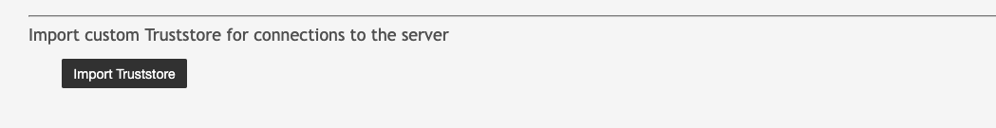
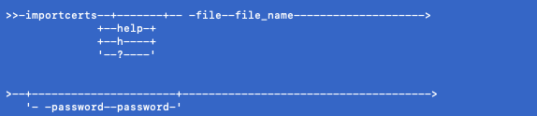
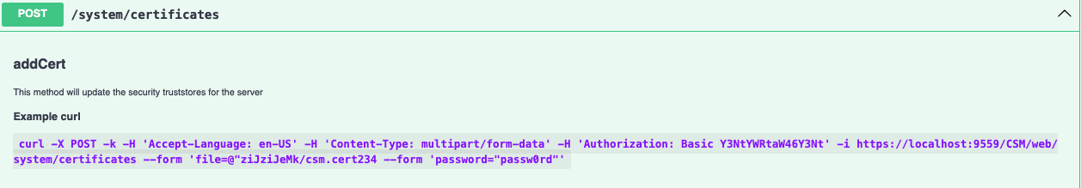
Allow new update certificate feature from 6.3.15 through CSM CLI and REST
CSM 6.3.15 improved how customers can manage custom certificates by merging the management of all connections in and out of CSM from the same set of certs
This support, however, was only in the GUI and could not be automated
Starting with CSM 6.3.16, you can now automate the management of certificates using either the CSM CLI or the CSM REST API.
The CSM CLI importcerts command takes in a file name and uploads the certificate to the server
The CSM REST API allows customers to upload the cert through REST or python

Slide 3
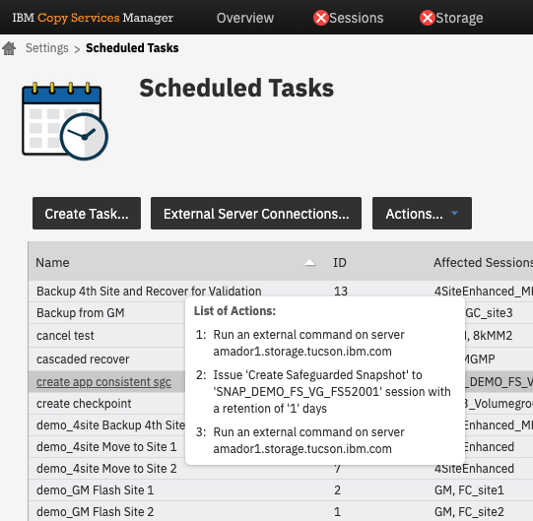
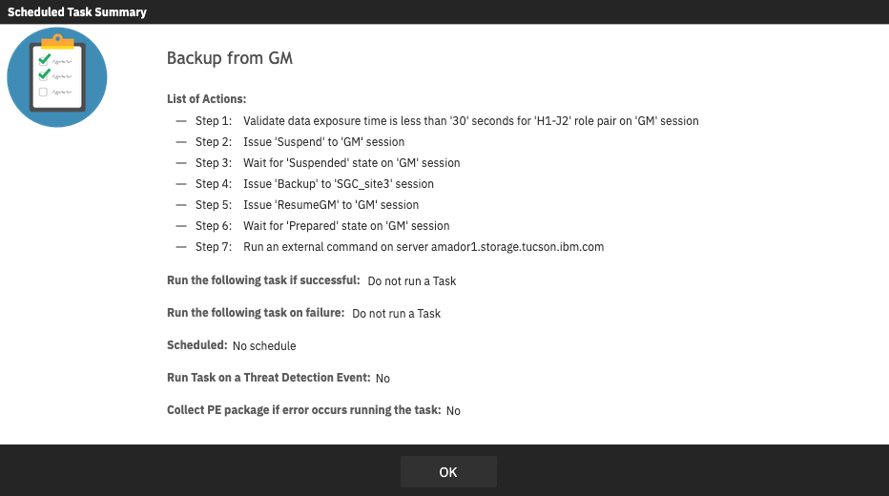
IDEA CSM-I-210 – New option to view a scheduled task without having to open the modify wizard
Scheduled Tasks in CSM are designed to allow customers to create their own workflows and build solutions based off of their personal requirements
Sometimes though you just want to double check that you configured that workflow correctly
In the past, to check the actions in a scheduled task you had to click on the view/modify and then cancel or save the task.
This process can be time consuming as you have to go through a lot of other screens to get to the list of actions
Starting with CSM 6.3.16, we now provide two ways to view task without having to go into the modify wizard
  Hover over – provides a quick popup of JUST the actions for a “quick peak”
  Click on Task – provides a popup that lists all the actions, the schedule and a full summary of the task

Slide 4
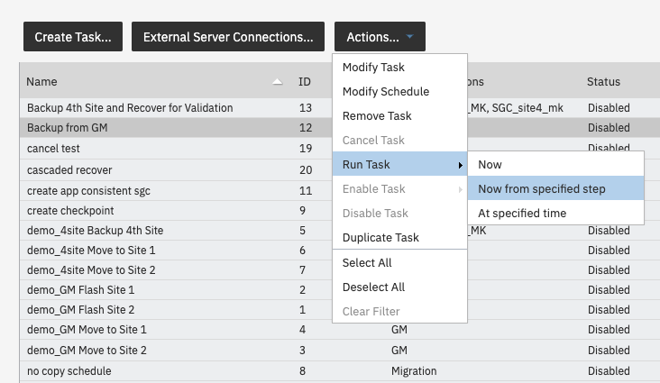
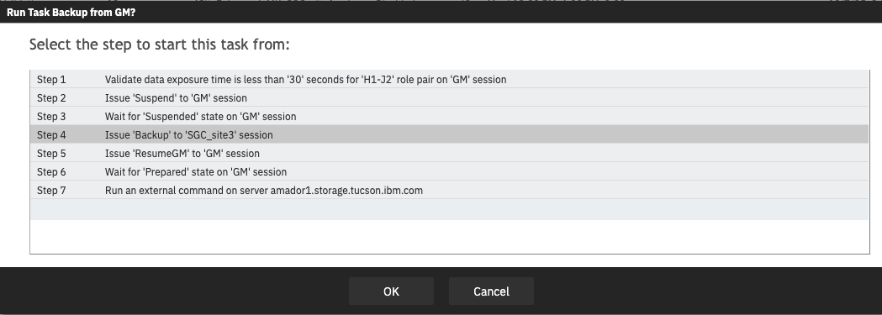
IDEA CSM-I-211 – Ability to manually start a scheduled task from any step
Sometimes tasks with multiple do not run according to plan
An action might have been configured wrong and lead to the task failing before all actions have completed
In the past, you would have to remedy the issue but then run each of the actions manually, directly on the session
Starting with CSM 6.3.16 though, you can now issue the Run Task->“Now from specified step” to run the task starting at the step you choose!
Note that this option is not available for “Run at specified time” or as part of the scheduled time…it is currently intended for a quick rerun manually from the GUI

Slide 5
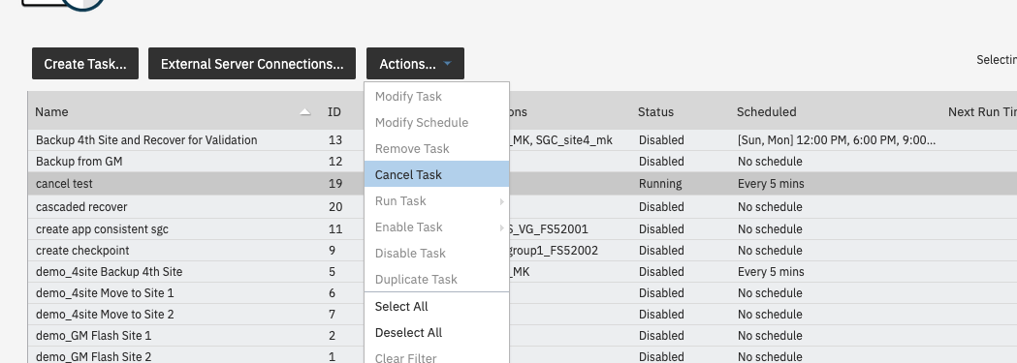
New ability to cancel a currently running task
Today once a task starts running, you cannot do anything else with that task until all actions complete successfully or an action fails
Starting with CSM 6.3.16, the new Cancel Task command is available which will allow you to cancel the task if it’s running
The task will only cancel once the current action being executed completes
After the current action completes a console message will indicate that the task was canceled and the status will show the last action run

Slide 6
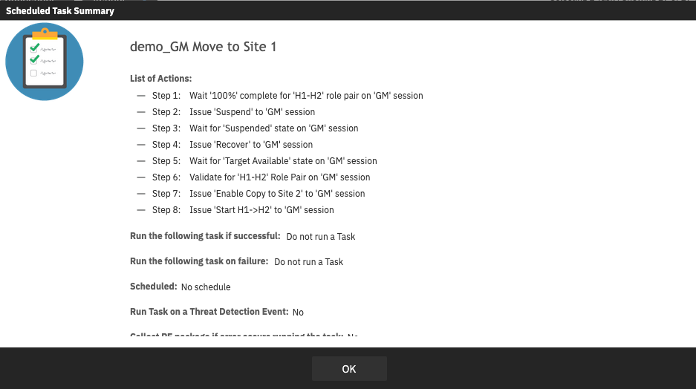
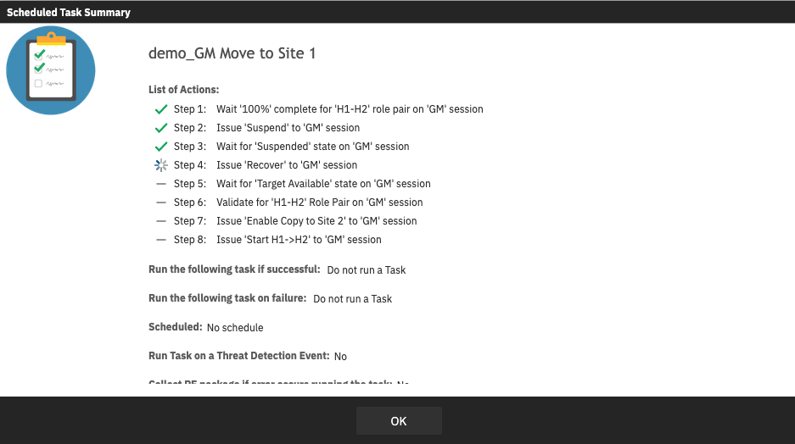
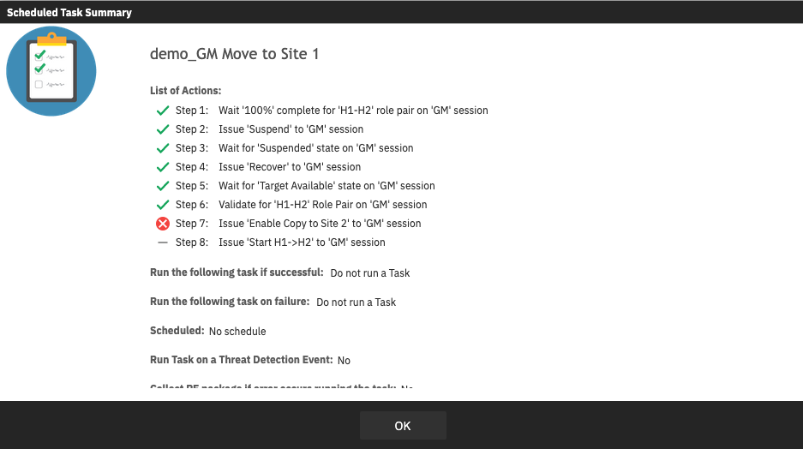
IDEA CSM-I-212– View running status and last run status of actions within a scheduled task
In previous releases, once a task started running, the only way to track the current status was to review the console logs
This can be difficult if a lot of other messages are occurring at the same time
Starting in CSM 6.3.16, the popup view of the task, will display a “running”, “success”, “failed” or “not executed” icon next to the step
This status is updated live so you can see the current step being executed
The status of the last run will remain historically in the popup view until the server is rebooted

Slide 7
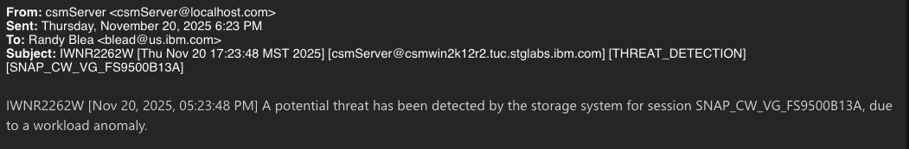
IDEA CSM-I-221 – Provide more details in subject of email notifications, to allow for easier filtering
In previous releases, when the CSM server was setup for email notifications, an email was sent where the Subject contained the IWN message ID and the Body contained the entire message
Starting with CSM 6.3.16, additional information will now be added to the Subject of all email notifications
This additional information will make it easier to create filter rules for email receivers
The Subject will provide the following extra details
  message_ID [time_stamp] [server] [alert_category] [list of message inserts]

Slide 8
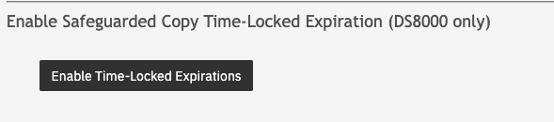
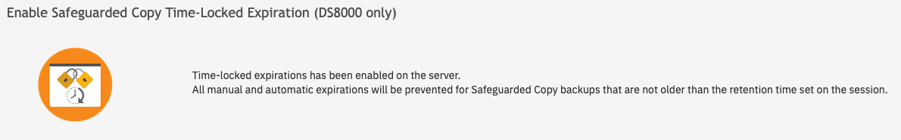
New DS8000 support for enabling Time-locked Expirations on SGC backups
Today SGC backups will get expired based on the retention time set on the session, and the last successful backup, however, manual expires are allowed without regard to the retention time (Dual control is highly recommended to manage this)
Starting with CSM 6.3.16, from the Settings -> Advanced Tools panel customers can enable a new mode on the server which will make SGC backups expire based on time instead of the last successful backup
When enabled, an SGC backup cannot be expired, even manually with Dual Control!
Once enabled, the feature cannot be disabled and the standby server will automatically enter the mode as well
WARNING: While this mode provides greater lock-down for SGC, because you cannot manually delete backups, if a volume’s backup capacity is exceeded, you will need to wait until enough backups expire before new backups can be created

Slide 9
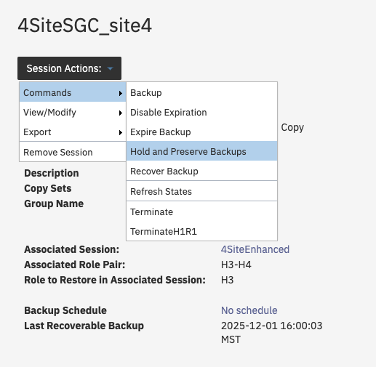
Hold and Preserve / Release and Disable Expiration / Enable Expiration commands
New commands are now available when the server is placed in the SGC time-locked mode
Hold And Preserve Backups
  This mode allows you to put the SGC session into a state when NO backups will expire, and no new backups can be created.
  When the Release Backup Expiration command is issued, the session will automatically extend the life of ALL backups based on the duration of the “hold”. This is useful for weekend or holidays so that backups are only managed during business hours
Disable Expiration
  This mode allows you to simply Disable the expiration process in CSM. Backups will NOT be automatically expired despite their retention time
  When Enable Expiration is issued, all expired backups will be automatically deleted
  Could be used in the event of an attack…to preserve the existing backups

Slide 10
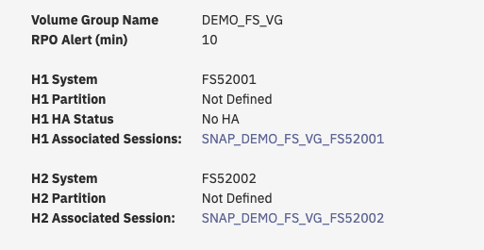

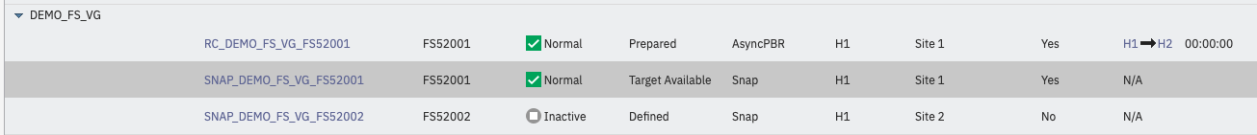
More enhancements for FlashSystems Snapshot and PBR support
Starting with CSM 6.3.16, CSM will automatically create a Snapshot session for all Volume Groups discovered on the FlashSystem in order to make it easier to manage with CSM
Customers will still need to manually create Scheduled Tasks to create Snapshots at a given interval and retention as the FlashSystem does not hold this policy any more for external management
The same applies when creating a Thin Clone of an existing Snapshot. A new Snapshot session will be created allowing you to manage the creation of snapshots against the Thin Clone. In addition, thin clones will display a special icon so that you can quickly tell that the session is a thin clone
When managing Async PBR session with CSM, CSM in a previous release started creating Snapshot session on each of the FlashSystems for the Volume Groups across sites. In this release, the Snapshot “site name” will automatically get updated to match the site name in the PBR session, to make it easier to see which Snapshot is for which site.

Slide 11
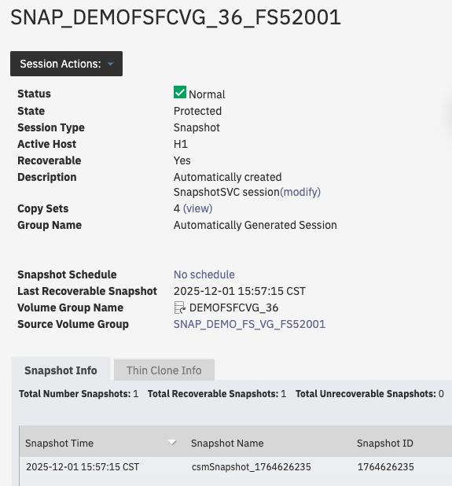
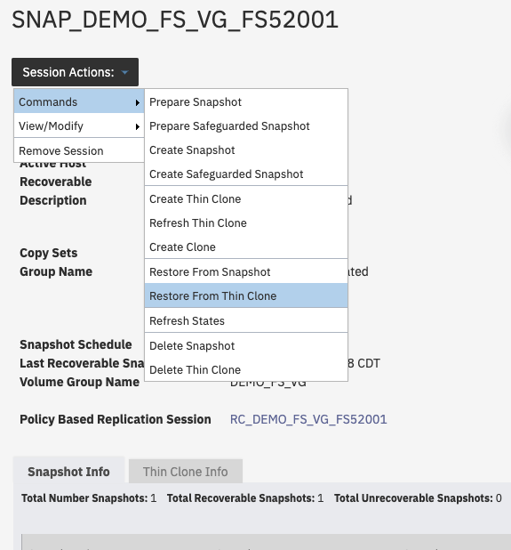
New FlashSystems support for Restore from a thin clone’s snapshot
In CSM 6.3.16, support was added for the FlashSystems new capability to restore a volume group from the snapshot of a thin clone
After creating a thin clone, CSM will automatically create a new Snapshot session
The icon next to the session name indicates it is a thin clone
If Snapshots are created from this thin clone, you can now issue the “Restore from Thin Clone” command
This new command is only available on the original Snapshot session, and will bring up a list of thin clones to choose from, followed by the lists of snapshots of that thin clone
If the restore is done, the data from the snapshot on the thin clone will get applied to the source volumes of the original source volumes
Thin clone
Original Snapshot session

Slide 12
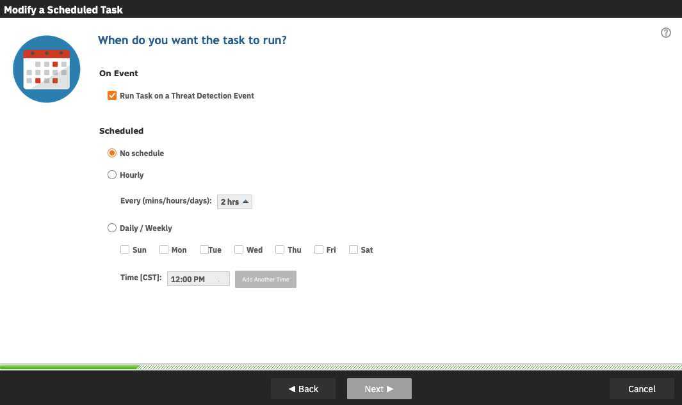
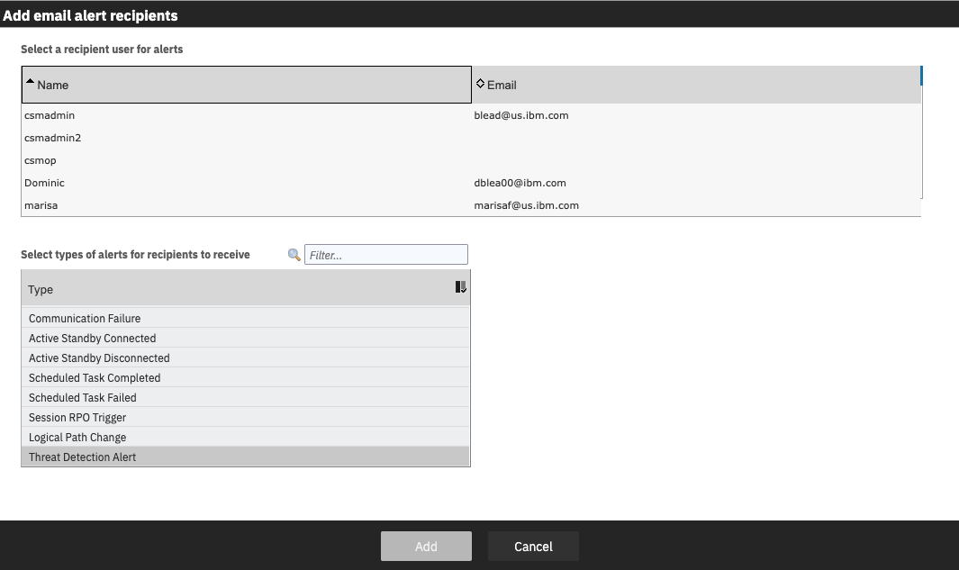
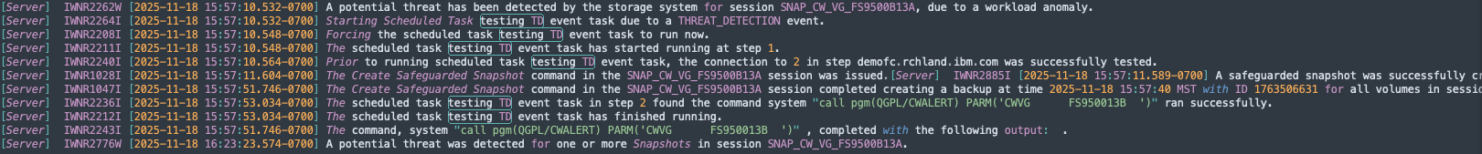
New support for handling FlashCore Module Threat Detection events for FlashSystems directly from CSM and automatically invoking automation!!!!
Starting with CSM 6.3.16, CSM will now monitor the FlashSystem event log for a 4300 threat detection event
In CSM you can set up the following if CSM sees a 4300 event
  Email alert notification through CSM
  Setup a Scheduled task to run on a Threat Detection Event
This solution provides quick reaction times and automation for potential threats
In addition, CSM will show which Snapshots occurred AFTER the event, and which Snapshots had their expiration extended due to the event

Slide 13
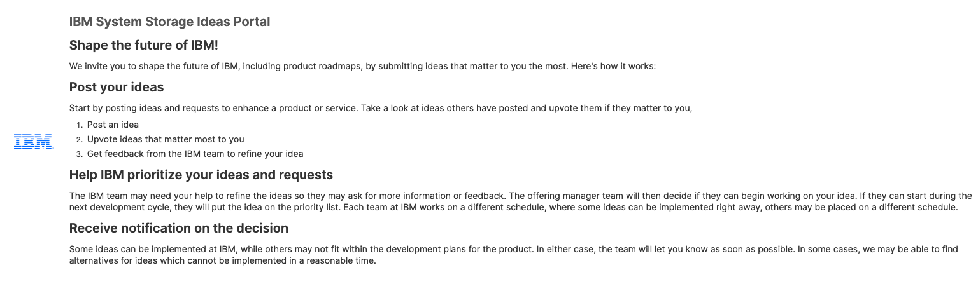
IBM System Storage Ideas Portal!!! -> New RFE Portal for CSM
https://ibm-sys-storage.ideas.ibm.com/ideas?project=CSM
The CSM RFE process has been converted to the new IBM System Storage Ideas Portal.
With the change, IBM is moving to a more common Aha! based process for customers to submit ideas across all IBM products.
All existing RFEs have been converted to Ideas. When you visit an RFE for status it will direct you to the Idea for that RFE in the Idea Portal.

