Slide 1
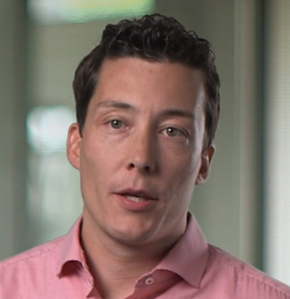
Business challenge
To stay ahead of the game with fresh innovation, business users at Bosch need super-fast, highly personalized IT services and the ability to enhance and add functionality on-the-fly.
“Using IBM POWER8 systems for the SAP HANA deployment gives us much more flexibility than we had before.”
—Eric Thorwirth, Senior Manager Server Services, Bosch
Transformation
With SAP S/4HANA®, Bosch gains deep operational insight. Massive performance from the underlying IBM® Power Systems™ servers and SAP HANA® database support rapid analytical queries.
Eric Thorwirth, Senior Manager Server Services, Bosch
Business benefits:
Unlocks
flexibility, fostering a culture of innovation Frees IT teams from routine management, so they can focus on value-add activities Superb reliability, performance and flexibility from SAP HANA on IBM Power Systems
Bosch Group
Unleashing massive flexibility to support game-changing innovation
Solution components:
SAP® BW/4HANA
SAP HANA®
SAP Hybris®
SAP S/4HANA®
SAP S/4HANA Finance
IBM® Cloud Orchestrator
IBM Power® System E880
IBM PowerVM®
SUSE Linux Enterprise Server
Robert Bosch is a worldwide operating company, employing 374,000 people and generating annual revenues of EUR 70 billion. Bosch operates its own IT division employing approximately 4,000 people.
Share this
Link
© 2016 IBM Corporation
Notes:
Client Name
Bosch Group
Company Background
Robert Bosch is a worldwide operating company, employing 374,000 people and generating annual revenues of EUR 70 billion. Bosch operates its own IT division employing approximately 4,000 people.
Business challenge
To stay ahead of the game with fresh innovation, business users at Bosch need super-fast, highly personalized IT services and the ability to enhance and add functionality on-the-fly.
The benefit
Business users can set up systems quickly with minimal support from IT, unlocking substantial time savings and fostering a rich culture of innovation to drive commercial success.
Pull Quote
“Using IBM POWER8 systems for the SAP HANA deployment gives us much more flexibility than we had before.”
—Eric Thorwirth, Senior Manager Server Services, Bosch
Solution components
SAP® BW/4HANA
SAP HANA®
SAP Hybris®
SAP S/4HANA®
SAP S/4HANA Finance
IBM® Cloud Orchestrator
IBM Power® System E880
IBM PowerVM®
SUSE Linux Enterprise Server
Case study Link
http://www-03.ibm.com/software/businesscasestudies/us/en/corp?synkey=H956255L37062F80

