Slide 1
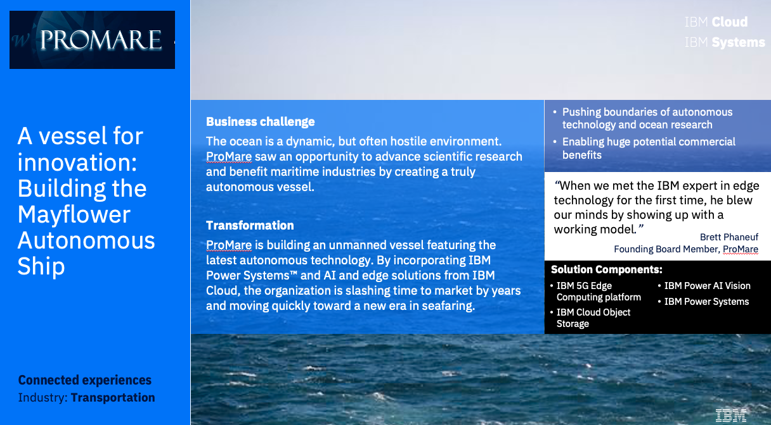
Securely store 5G data from edge devices with cloud efficiency and scalability
IBM Cloud Object Storage customers have lowered the cost of their storage an average of 44% and received payback for investment in only 8 months.
Why IBM
Multi-level parallel access with simultaneous high throughput from multiple read/write sources
Optimize capacity and performance with flexible geo-dispersed data and customizable accessor layer
Integrated real-time analysis with Spectrum Discover using continuous data and actions to create a data catalog with customizable metadata analysis
Stays online and easy to manage with extreme data durability and always on approach to data
Built-in security with patented SecureSlice encryption and SEC 17a-4 compliant WORM
Proven scalability with EB scale customers in production
Learn More
IBM Cloud Object Storage Business Value
IBM Cloud Object Storage Product Guide
Learn about IBM Cloud Object Storage Solutions
Business Value Report: https://www.ibm.com/downloads/cas/QV0VAKRB
Notes:
IBM Cloud Object Storage is a highly scalable cloud storage solution for unstructured data that provides both on-premises and cloud-based optimized storage solutions. It enables enterprises to store and manage massive amounts of data more efficiently and securely, with “15-nines” of system reliability and accessibility from any location. IBM Cloud Object Storage uses an innovative parallel access approach for cost-effectively storing large volumes of unstructured data. It delivers the capabilities required to provide continuous data with no downtime or data migrations. Customers can start with less than 100TB and grow to 100's of PB or even to EB configurations.

