Slide 1
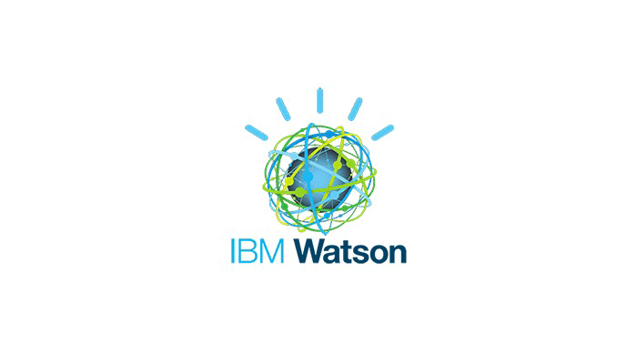
IBM Maximo EAM SaaS Flex
Offering Overview

Slide 2
01
02
03
04
05
06
The SaaS Model
Overall Architecture
Security
Performance
Integrations
Backup and Recovery
OVERVIEW
AGENDA

Slide 3
Maximo SaaS Flex Model

Slide 4
The IBM Maximo EAM SaaS Flex Model
Software delivered over the internet, managed by IBM, and paid for on a subscription basis.
Perpetual License Model
Software as a Service
Customer makes buying decisions and is integrator and maintainer of all components of the IT value stack
Customer makes application buying decisions. IBM makes decisions on components of the IT value stack
€
€
Services
Services
€
Application
Application
€
Middleware
Middleware
€
Integration
€
Operating System
Operating System
Pre-packaged
€
Servers, Storage
Servers, Storage
€
Network Infrastructure
Network Infrastructure
IBM supports multiple application codes, multiple application versions or a customized code for each customer
Customer must support entire stack
IBM Maximo EAM SaaS Flex option is a single instance and allow for options
IBM CDS team supports everything except Services needed for implementation / new features
There are many definitions of SaaS in the industry – important we all understand what is included and what is different

Slide 5
Cloud Delivery Services - In Context
Implementation:
Client, Systems Integrator, Business Partner, IBM GBS
Business Strategy
App Development, Design, Integration, Customization
Global support team for the CDS pieces
Application Operations/DB Management
IBM Cloud Delivery Services (CDS)
Physical Infrastructure & Network Management
Servers, Storage Maintenance
Application of Fixpacks, Featurepacks, Technical Upgrades
IBM Maximo Support & Development
Functional Application Support (PMRs, L2, L3)
5

Slide 6
Why some Clients Prefer SaaS to the Traditional Model
 | SaaS (Hosted, subscription) | Traditional (On-prem, perpetual)
OPEX vs. CAPEX | Operational Expense | Capital Expense
Cost Predictability | Higher | Lower
Skill/Staffing Requirements | Lower | Higher
Maintenance Costs | Included in subscription | 15-30% of license cost per year
Upgrades and patches | Included – stay current | Customer responsibility, cost
Support and infrastructure | Included – focus on business | Customer responsibility, cost
Strategy | Move to SaaS as preferred option
Maintenance, support staffing, and infrastructure
SaaS Can Offer Flatter, More Predictable Costs
License (CAPEX) & implementation
Upgrades
Low initial -- OPEX
Low, predictable yearly costs

Slide 7
Quick facts
A complete IBM solution including software, infrastructure and personnel
Supporting over 200 Maximo customers
Implementations in all GEO’s, 40 countries represented
Every industry solution is being utilized
Integrations to multiple 3rd party and customer site applications utilizing the full MIF capabilities
Yes, our team does use Maximo SaaS to manage our internal business including tracking customers, assets, change tickets and service tickets

Slide 8














Cloud Delivery Services (CDS) and Maximo SaaS Flex
IBM’s Cloud Delivery Services team has been hosting Maximo systems for over 15 years
Deep experience provisioning and supporting Maximo in the cloud
Solely focused on Maximo and Tririga SaaS delivery
Provide managed services for both the infrastructure and operational support of Maximo
Teams are located globally
Every client has dedicated application and database instances
RESO

Slide 9
Why SaaS “Flex”
The strength of Maximo is its ability to be configured to meet a client’s specific requirements.
Industry Solutions
Add-on’s
Development methodology
This extends to the requirements for how the application is delivered and managed
SaaS Flex offers flexible options to clients to meet their specific requirements
Order what you need when you need it
Additional environments – add or change
Connectivity options

Slide 10









Included with every SaaS Flex Order
Sites
Database and O/S
Monitoring and Backups
One production and one non-production site included.
Installation of O/S, database and other system software required.
Configuration of monitoring and backups as well as any DR requirements.
Sizing and Architecture
DNS Registration and SSL Certs
One VPN, one SFTP
Sizing and architecture based on IBM Best Practices supplemented with Heuristics gained from 10 years of hosting.
Registration of DNS and all SSL Certificates required.
Setup of VPN and sFTP if needed.
Infrastructure
Installation of applications
Standard Integration Config
Commissioning, configuration and networking of required infrastructure at the selected IBM Data Centre.
Installation of the appropriate version of software plus all purchased add-on’s.
Assist client with setting up integrations using standard integration tools
SSO
Ongoing upgrades
System Admin and DBA
Configuration and set up of SSO using appropriate SAML, or LDAP authentication with client Identity Provider.
Upgrades to application, database and system software as required.
System administration and database administration support throughout the engagement.

Slide 11
What is available?
IBM Maximo EAM SaaS Flex delivers Maximo – not a modified or restricted version – the full feature set is available and the customer maintains control of the Maximo Administrator User.
With every order, the following are included:
Core Maximo Asset Management (MAM)
Maximo Integration Framework (MIF)
Everyplace
The ‘Flex’ part allows you to order the parts you need and only the parts you need. These include, and this list will grow as new Maximo Solutions are offered:
Anywhere | Calibration | Transportation | Service Provider (SP) | Scheduler
Oil and Gas | Utilities | Nuclear | Life Sciences | HS&E
Aviation | Asset Configuration Management (ACM) | Linear | Spatial | Asset Health Insights

Slide 12





Optional Enhancements for Maximo SaaS Flex
Additional Environments
Additional Capacity
DR and SLA
Additional non—production environments or databases to fulfill customer requirements.
For production and non-production sites. Add JVM’s or bare metal servers
Enhanced DR options and SLA for non-production
Communications
Development
Other
Additional VPN, sFTP, IP Specifications for access,
Development environments with enhanced access
SAP and Oracle Adaptors and Blockchain

Slide 13
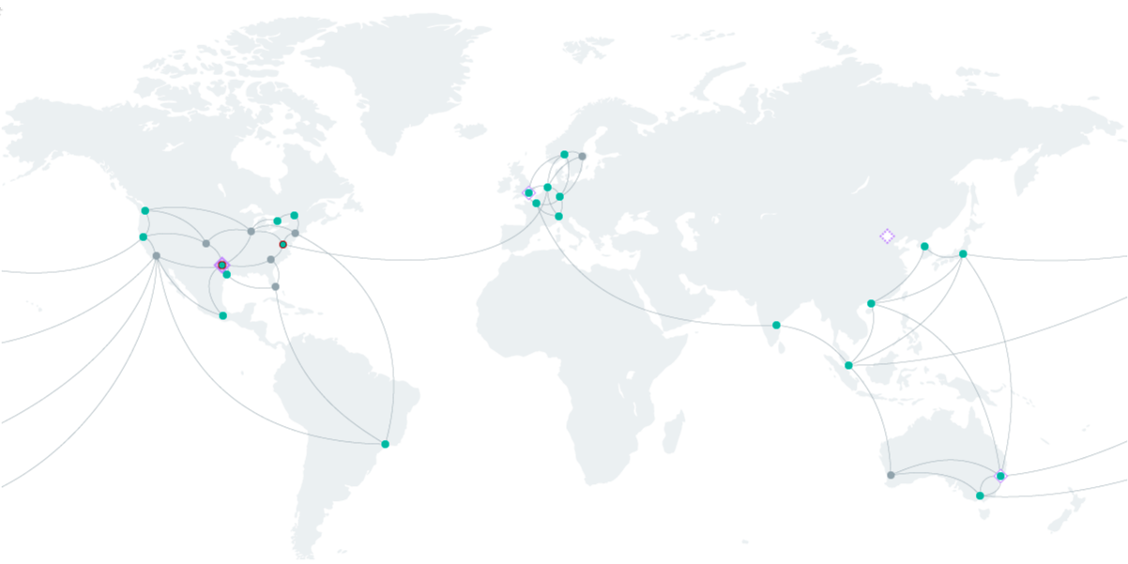
Delivered using IBM Cloud and IBM Teams
SaaS Flex services are delivered on the IBM Cloud
Provisioned from 15 IBM Cloud data centers located in the US, Europe, Canada, Australia & Asia
We provision separate, dedicated application & database servers for each customer environment (TEST, PROD, etc) with a dedicated instance of Maximo and database for each client
CDS Team located around the globe
Notes:
13
13

Slide 14
Additional Services – May involve a separate SOW through lab services
3rd party add-ons
The CDS will work with the client to understand if a 3rd party tool can be implemented within the SaaS offering and ensure we can support it
Oracle is considered a 3rd party tool and is approved for use within the Maximo SaaS Flex offering with the caveats noted previously
Migration
Lift and shift is not covered under the base SaaS order and needs to be scoped and priced
Upgrades and database migrations may need to be performed prior to migration
Replication to off-site databases
Exclusions
Business Intelligence and data warehousing tools (including Cognos) will NOT be implemented within the SaaS environment. It can be integrated to, but not within and supported by the SaaS Team.
Configuration, customization or the application, as well as Level 1 support and user management is the Client responsibility

Slide 15
Basic Architecture

Slide 16
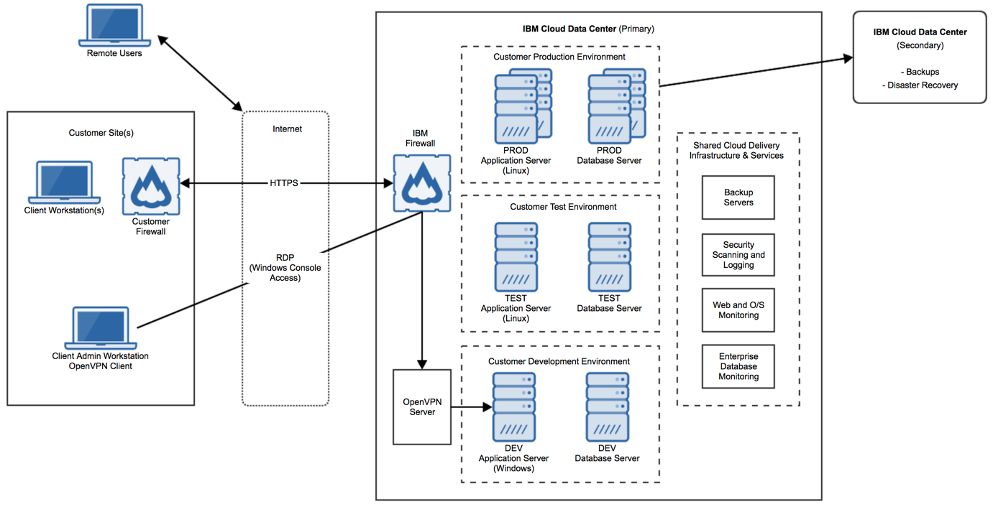
SaaS Flex Architecture (example)
High Level Maximo SaaS Architecture Wiki entry

Slide 17
Maximo Architecture
Every client is implemented on dedicated VM’s (or optional Bare metal servers)
Production and non-production systems are implemented on red hat Linux
Development environments are implemented using MS Windows
Webserver is IBM Websphere
Default database is IBM DB2 – Oracle can be supported – see next slide
Sizing depends on User order
Start with Maximo best practices
Modified within the SaaS environment using heuristics developed from our 15 years of implementing and supporting Maximo

Slide 18
Databases
DB2 is the default database and comes standard as part of the Maximo SaaS order
Oracle is supported by the CDS team to the same level as DB2. There are two caveats though:
Customer must supply their own Oracle licenses. In particular:
Oracle Database Enterprise Edition (must be a processor based license)
Oracle Advanced Security (for encryption at rest)
Oracle Diagnostics Pack
Oracle Tuning Pack
Oracle Active Data Guard
Oracle requires bare metal servers. Recommendation is 2.
Please contract CDS team to confirm details
SQLServer is not a supported database

Slide 19
Network Architecture
IBM Cloud has a unique Triple Network architecture. Every server provisioned has 3 distinct networks.
Public Network Two network interfaces are dedicated to the public network. This network serves as the internet facing network for the server. IBM SaaS uses this network as a way for external clients to access the application. These network interfaces can be turned off if direct internet access is not required. (For example, an application or database server that is accessed by another server via the private network - see below). This network is also secured by provisioning hardware or software firewalls which are managed by IBM Cloud Delivery Services.
Private Network Two network interfaces are dedicated to the private network. This network serves as a secure private network dedicated to IBM Cloud. IBM Cloud can use this network for secure server to server communication as well as data center to data center communication. This network has no access to the internet. The client's internal network may connect to this private network via IPsec VPN connection if required.
Management Network One network interface is dedicated to the Management network. This secure out-of-band network is accessible via VPN. It is used for maintenance and administration purposes such as firmware updates, OS reloads, power-cycle or other IPMI functions like keyboard, video, mouse control (KVM over IP)

Slide 20
Security

Slide 21
Maximo Security
Security is a main priority for any customer, and we have an extensive security program as part of our Maximo SaaS delivery
Covers:
Access by clients
Data Center Security
IBM Personnel
Encryption
Penetration and vulnerability testing
Security certifications and compliance
Media sanitization

Slide 22

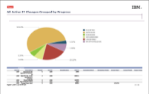
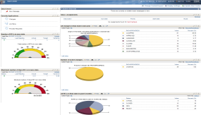
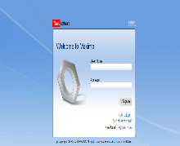

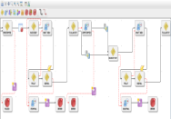
Maximo Security
Client Access
All CDS Maximo and TRIRIGA SaaS customers use HTTPS (SSL) encryption (256 bit) at the browser level to access IBM hosted applications. Connections are SHA-2 and TLS v1.2 compatible.
IBM obtains and implements externally facing SSL certificates from a trusted Certificate Authority (CA)
For Production and Non-production systems, no access is allowed to the operating system, files system or websphere console
Development Environments allow greater access via a secure portal
IBM Personnel (CDS) do not log into the application
Self Service Users
Internet
IBM SmartCloud
End Users
HTTPS Session
Role-based IT Staff:
Supervisors
Planners/Schedulers
Technicians
Purchase/Inventory
Maximo - SaaS
Administrator/Manager
Firewall

Slide 23
Maximo Security
Data Center (IBM Cloud) Security
All data centers have 24 x 7 onsite security
Only authorized IBM Personnel are granted access
IBM Cloud holds ISO-27001 certification and can provide SOC 1, 2 and 3 reports to customers
Other IBM Cloud certifications include ISO-27017, 27018, MTCS Level 2 as well as PCI and HIPAA compliance
IBM Cloud data centers are not Tier certified, but are built to Uptime Tier 3 specifications
On site customer visits to IBM Cloud data centers are not allowed
Below are two video tours of IBM SoftLayer Data Centers that describe our general layout and architecture. Please note IBM acquired SoftLayer in 2013 and it is now referred to as "IBM Cloud"
https://www.youtube.com/watch?v=U1ROjNxTcqQ
https://www.youtube.com/watch?v=-sk-zjRfXSk

Slide 24
Maximo Security
IBM Personnel
All IBM Employees undergo security and background checks as part of their onboarding
Annual training includes Privacy, CyberSecurity, GDPR, Business Conduct Guidelines among other courses related to security
Only IBM Personnel from the CDS team have access to the Maximo SaaS servers
Least Privileged access principles are followed
Separation of duties are maintained and reviewed
Frequent User Access reviews are conducted
Privileged access workstations are required to connect to IBM Cloud
IBM CDS personnel who are granted O/S or console level access to Maximo SaaS servers require unique 2048-bit ssh keys in order to connect to the IBM Cloud VPN. These are issued and managed by the CDS Environment Operations Manager.

Slide 25
Maximo Security
Encryption
Data is encrypted at several stages in the Maximo SaaS Flex offering
All CDS Maximo SaaS customers use HTTPS (SSL) encryption (256 bit) at the browser level to access IBM hosted applications
Add Data is encrypted at rest for DB2 customers (For customers using Oracle, the Oracle Security Module needs to be purchased)
All backups are AES-256 encrypted and can only be restored to servers with the appropriate encryption key

Slide 26
Maximo Security
Penetration and vulnerability testing
IBM employs a third party that conducts penetration testing on Maximo SaaS annually. An executive summary report can be provided to customers upon request. A signed non-disclosure agreement (NDA) with IBM must be in place in order to share this report.
IBM performs vulnerability scanning and subsequent remediation in all Maximo SaaS environments on a quarterly basis per IBM corporate security guidelines.
Vulnerabilities are assigned individual vulnerability ratings and exploitation categories (High, Medium or Low). These ratings are used to determine an IBM mandated time requirement to remediate and resolve the vulnerability.
Vulnerability scanning results and logs are considered IBM Confidential Information and are not disclosed to customers or prospects.
Customers are not allowed to perform external penetration or vulnerability testing in any IBM Maximo environment per IBM corporate security policy
Results of the testing and remediation efforts are part of our annual audit for the SIO 27001 Certification

Slide 27
Maximo Security
Security certifications and compliance
IBM Maximo SaaS environments are ISO-27001, 27017 and 27018 certified. These certificates are publicly available and can be viewed / downloaded via the links below. ISO-27001: https://www.ibm.com/common/ssi/cgi-bin/ssialias?htmlfid=KUJ12445USEN& ISO-27017: https://www.ibm.com/common/ssi/cgi-bin/ssialias?htmlfid=KUJ12466USEN& ISO-27018: https://www.ibm.com/common/ssi/cgi-bin/ssialias?htmlfid=KUJ12467USEN&
IBM Maximo SaaS will be obtaining SOC-2 compliance by end of year 2020.

Slide 28
Maximo Security
Media sanitization
IBM securely sanitizes physical media intended for reuse prior to such reuse, and will destroy physical media not intended for reuse, consistent with National Institute of Standards and Technology, United States Department of Commerce (NIST) guidelines for media sanitization
Complete details on Maximo SaaS Flex security can be found here:
https://www.ibm.com/developerworks/community/wikis/home?lang=en#!/wiki/Cloud%20Delivery%20Services%20-%20Maximo%20and%20TRIRIGA/page/Security

Slide 29
Performance

Slide 30
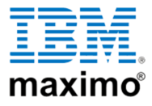
Cloud Delivery Services (CDS) and Maximo SaaS Flex
Performance Overview
Performance affected by many different components
Includes
servers and configurations
Network
Maximo configuration including queries, start centers
Customer network
Customer device
Internet connection amd bandwidth
CDS Wiki:
Welcome to Maximo SaaS Wiki page link
Notes:
30
30

Slide 31





Maximo SaaS – Performance Considerations
Application
configuration
Internet connection
And routing
Load balancing
/ configuration
Database
indexing
Client network
And firewall
Data center network
And fireall
Server sizing for app
And database
Each of these could be a potential source of a performance issue
Cooperation is essential to quickly identify the source and the
appropriate resolution
User and
their devices

Slide 32
IBM Cloud
All SaaS services are delivered on the IBM Cloud
Systems provisioned from IBM Cloud data centers in the US, Europe, Canada, Australia & Asia
Minimum of 40 Gbps of connectivity to each rack where systems provisioned
Multiple Network Points of Presence (PoPs) worldwide allow most direct path to your
primary data center and IBM on Cloud environments, minimizing latency
Notes:
32
32

Slide 33
SaaS Flex Architecture (example)
Systems are provisioned and configured for optimal performance for the number of users
Dedicated JVM’s for integrations, reporting, batch workloads and user interfaces as needed
Load balancers to distribute work across JVM’s
Optional replica databases to move load away from production use

Slide 34
Maximo SaaS – Performance
CDS does not have access to any client application so we do not monitor individual screen performance
Performance of an individual site is a shared responsibility between the client and CDS
Performance issues are investigated to identify the cause and the appropriate solution

Slide 35
Integrations

Slide 36
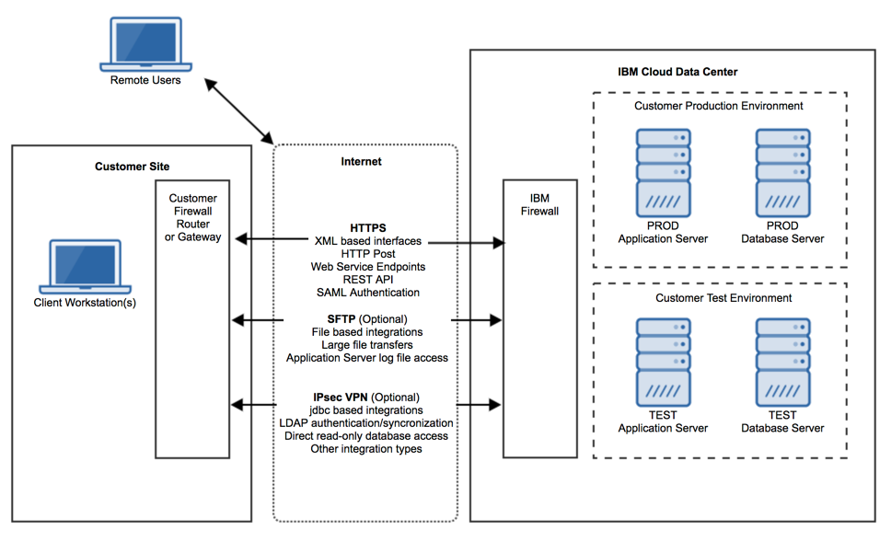
SaaS Flex - Integration Support

Slide 37
Maximo SaaS – Integrations
Support for synchronous and asynchronous exchange of data with Maximo
Use of common protocols and format such as Web Services, HTTP, JMS, REST, OSLC, XML, JSON, XML and .csv files, DB tables
Support of Create, Replace, Update, Delete and Query operations
Maximo integration message generation and delivery based on application object events
Support for implementation (batch) data loading
Pre-defined (75+) interface components provided along with applications to configure new interfaces
Support for customizing integration processing using Processing Rules and Scripting

Slide 38
Backups and Disaster Recovery

Slide 39
Maximo Backup and Disaster Recovery
Backups & Data Retention (IBM Maximo SaaS)
Backups are performed 7 days a week. Full backups are performed every Saturday. Incremental backups are performed Sunday through Friday.
File system backups for all servers are routed to a local Enterprise Backup Server for near line storage (quick retrieval)
Production file system backups are taken every 4 hours. Non-production file system backups are taken every 12 hours
On a daily basis, all file system backups are replicated to a remote (secondary) IBM Cloud data center in the same country or geography.
All backups are AES-256 encrypted and can only be restored to servers with the appropriate encryption key
Production backups are kept for thirty one (31) days. Non-production backups are kept for seven (7) days.
Upon receiving a support request from client within 30 days of the Cloud Service expiration or termination date, IBM will return to client an electronic copy of client’s content in the native application format.

Slide 40
Maximo Backup and Disaster Recovery
Disaster Recovery
 | Standard DR | Enhanced DR
Recovery Point Objective (RPO) | 24 hrs | 1 hr
Recovery Time Objective (RTO) | 72 hrs | 12 hrs
IBM Cloud Data Centers Utilized | 1 (primary) | 2 (primary and secondary)
Passive standby system at secondary data center | No | Yes
IBM DB2 HADR (High Availability) at primary data center | Yes | Yes
Maximo Application HA at primary data center | Yes | Yes
High Availability at standby data center | N/A | No
Live Replication to standby data center | N/A | Yes

Slide 41
Some helpful links and information
Whom do I contact about questions around SaaS, RFP’s, the Customer Delivery Team
Michael Cookson (Michael.Cookson@ibm.com)
Don Woodward (donw@us.ibm.com)
Is there a publicly available site with information?
- CDS Wiki
- continually updated with new information, details or clarifications

Slide 42

THANK YOU
QUESTIONS?

