Slide 1
IBM zStudent Opportunities —

Slide 2
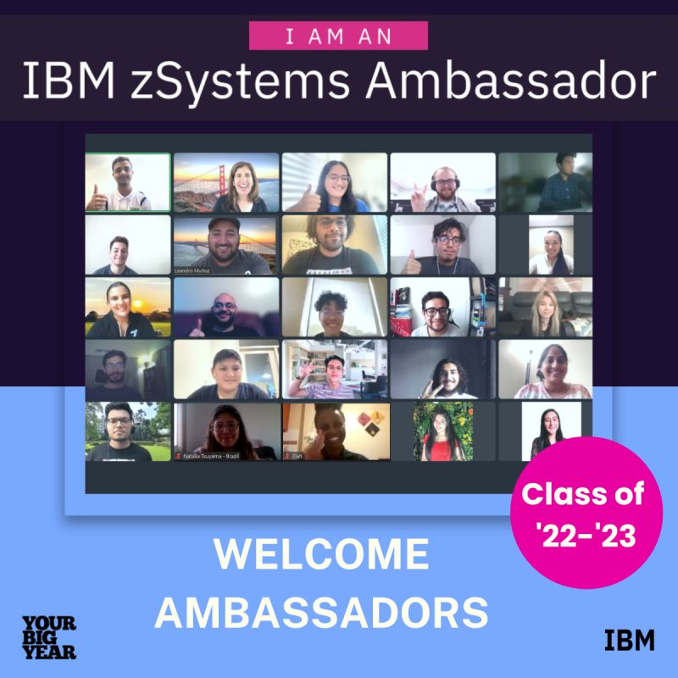
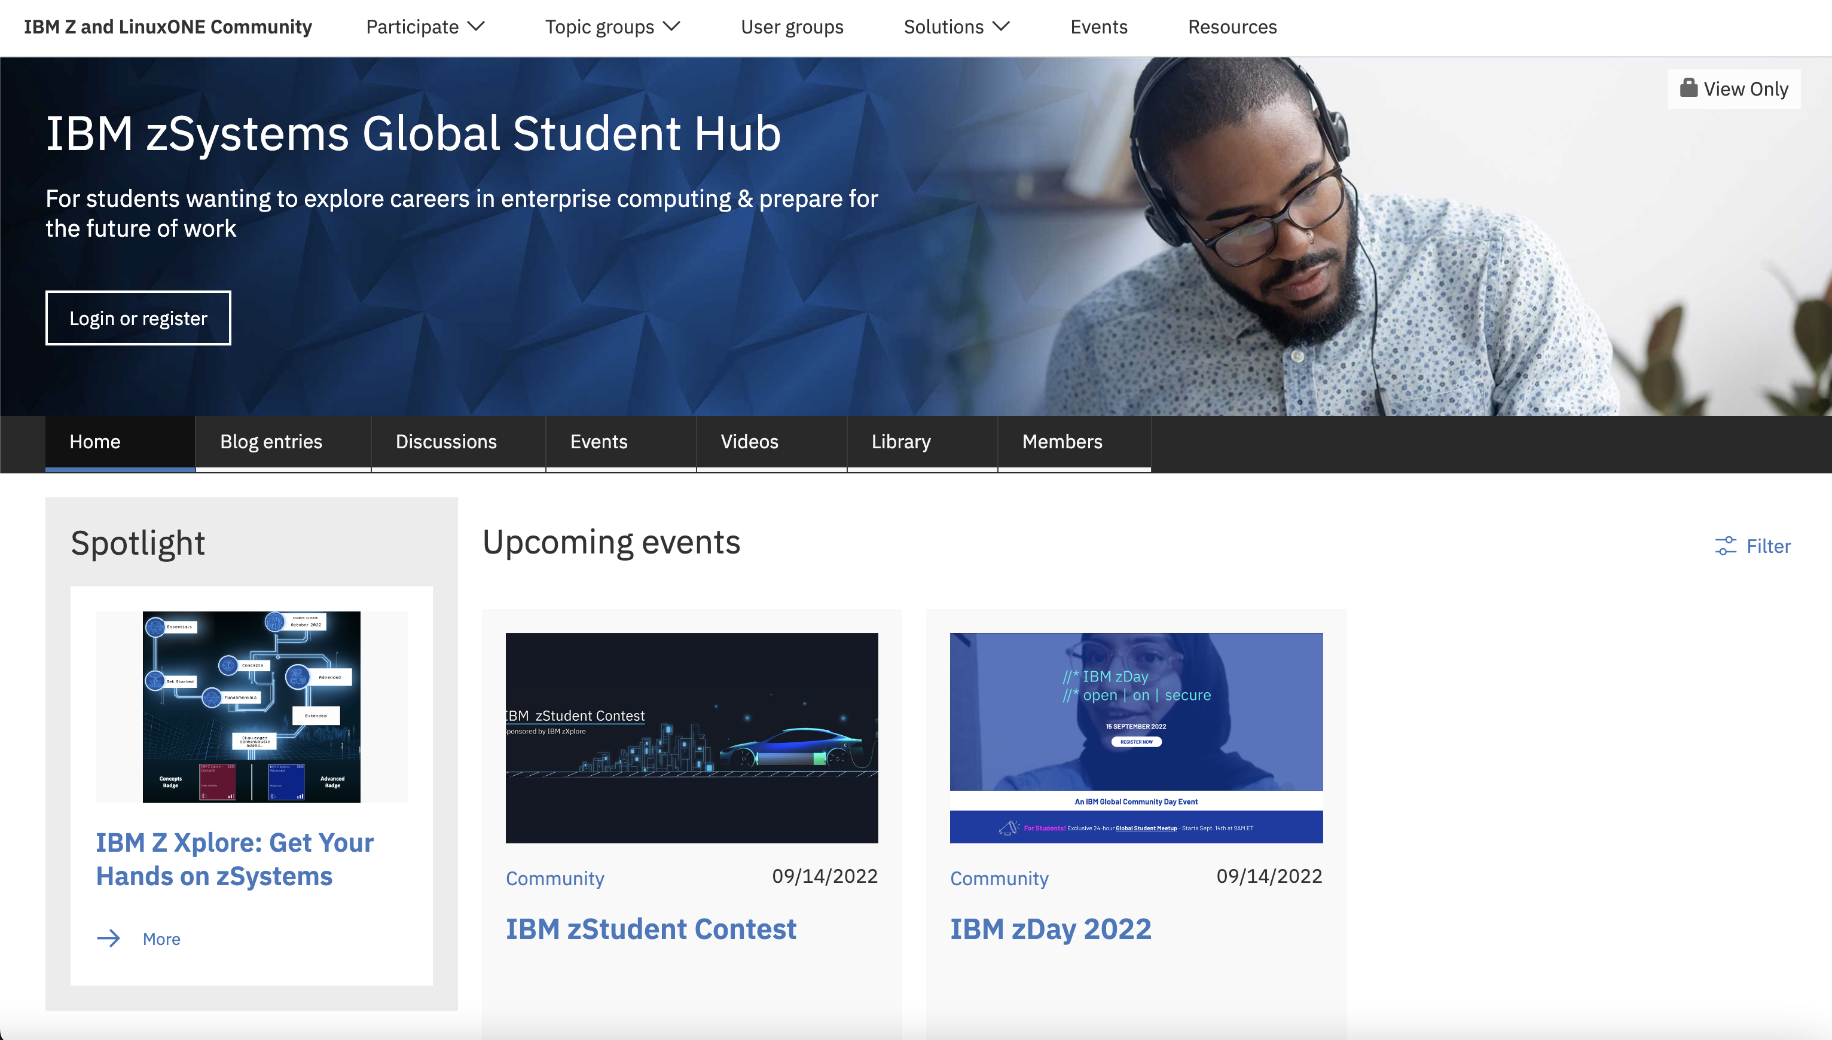
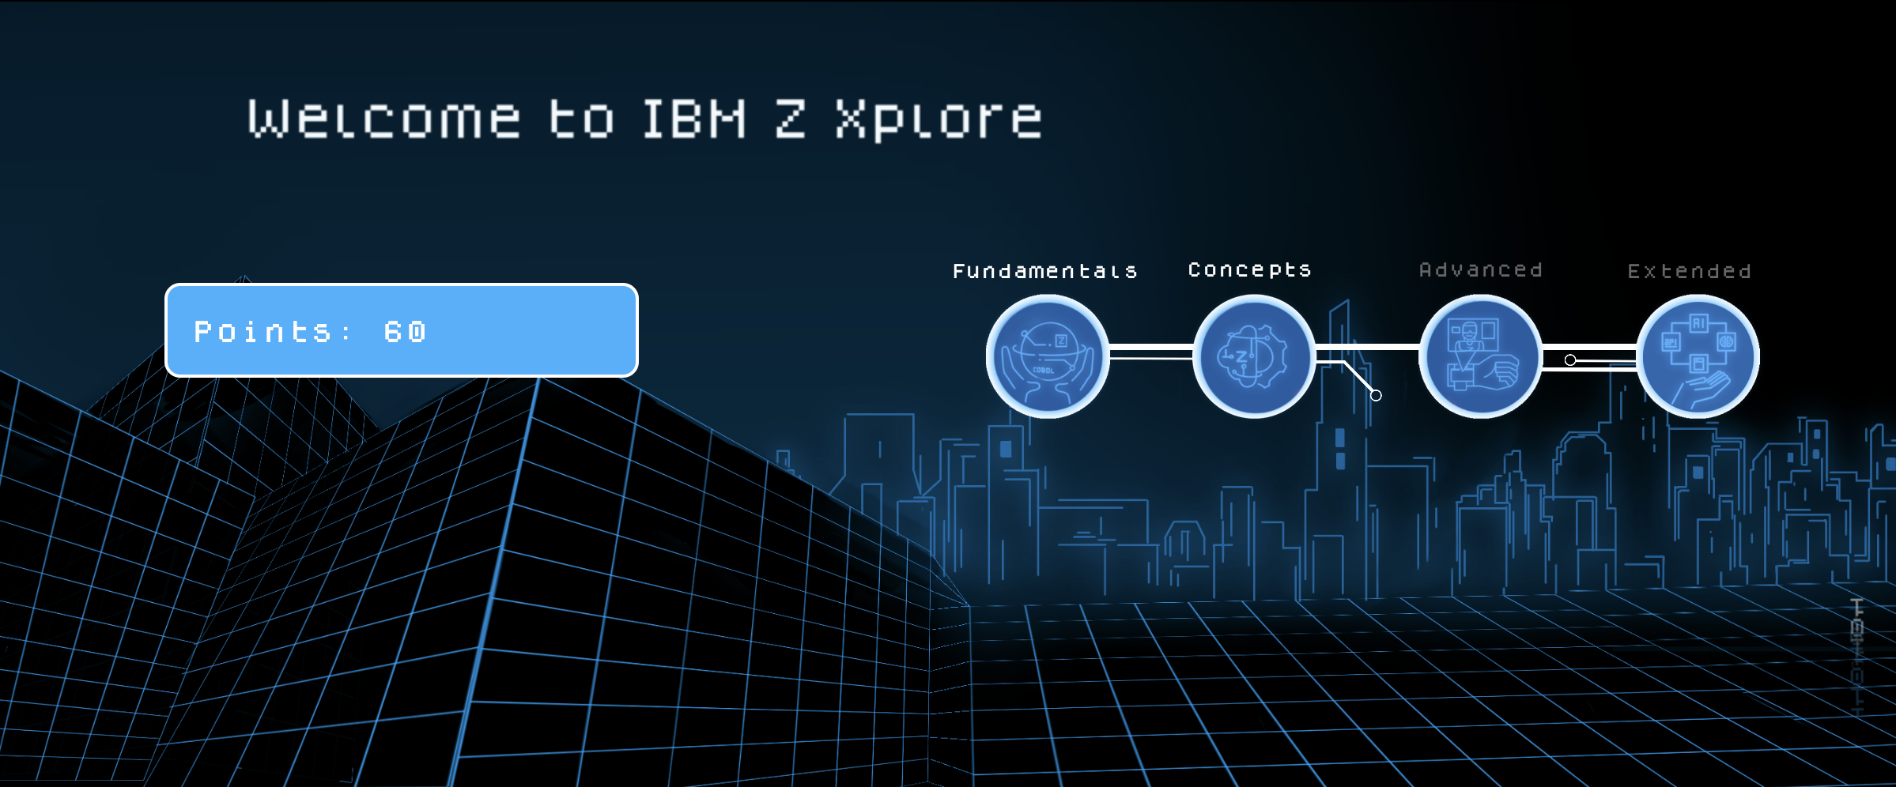
IBM zSystems wants to support you as a student!
IBM zSystems Ambassador Program
IBM zSystems Global Student Hub
IBM Z Xplore and the IBM zStudent Contest
Virtual Enterprise Computing Career Fair Sponsored by IBM

Slide 3
IBM zSystems Ambassador Program
Being an IBM zSystems Student Ambassador means being part of a leadership program designed for your personal and professional development. As a leader and role model in your local university and community, you will:
Earn technical certification in mainframe technology
Network with industry professionals and peers
Gain valuable leadership skills
Connect with companies who hire for IBM zSystems skills
Represent all things IBM zSystems on your campus
Represent your University nationally and globally

Slide 4
IBM zSystems Global Student Hub
The Global Student Hub is the place to be to connect in to all of the great opportunities IBM zSystems has for you as a student!
Crowdcast event series designed to help you succeed technically and interpersonally
Blogging opportunities to start your advocacy journey
Connect with other students and IBMers to grow your network
Stay tapped in to all things new with zSystems!
Student Hub

Slide 5
IBM Z Xplore and the zStudent Contest
IBM Z Xplore is the always on IBM zSystems learning platform!
Get hands on with a real zSystems environment
Earn industry recognized badges
Cash in points you earn along the way for swag!
The IBM zStudent Contest allows you to use your IBM Z Xplore skills to compete for cash prizes!
Z Xplore Concepts badge required to participate
Find and collect the most sustainable fuel cells to power your zMobile car
3 global winners can win $1500 each and 6 regional winners will win $1000 each!
Student Contest Reg
Z Xplore

Slide 6
Virtual Enterprise Computing Career Fair Sponsored by IBM
This is your chance to show off your IBM zSystems Skills to IBM clients and business partners who are actively looking to hire!
For students and jobseekers eligible to work in the US
IBM zXplore concepts badge required for participation
Register today!

